Slide 1
Review- July 28

Slide 2

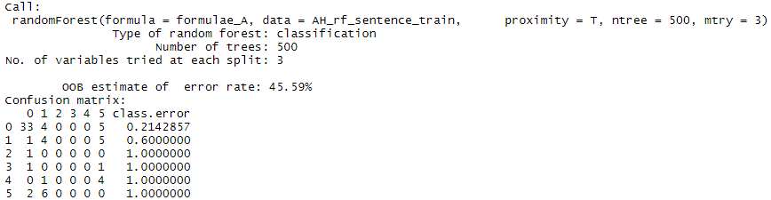
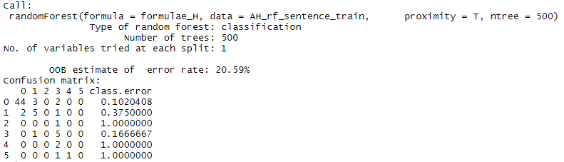
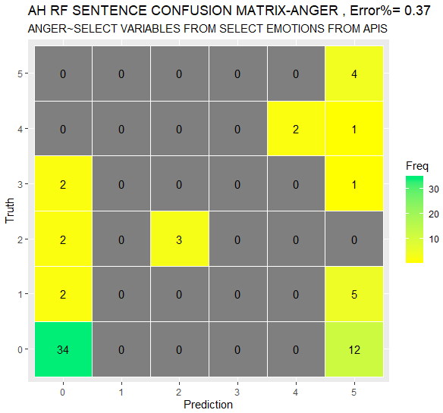
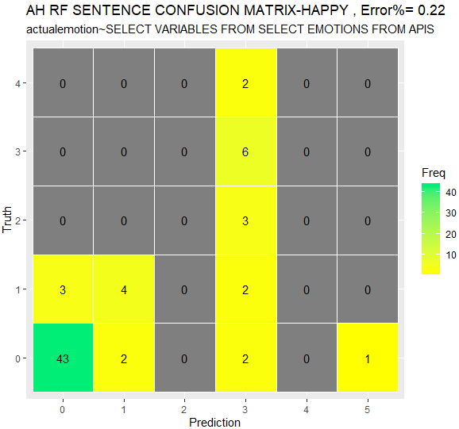
MS Analytics
ANGER
HAPPY
Threshold Considered
Error:
32%
Threshold Considered
Error:
7%

Slide 3
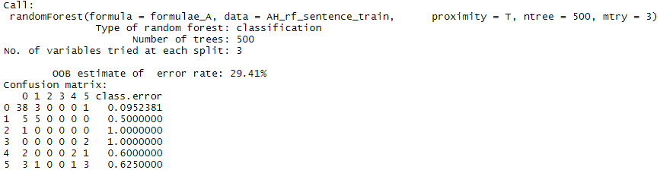
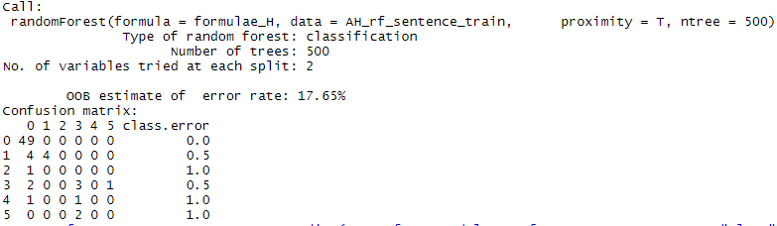
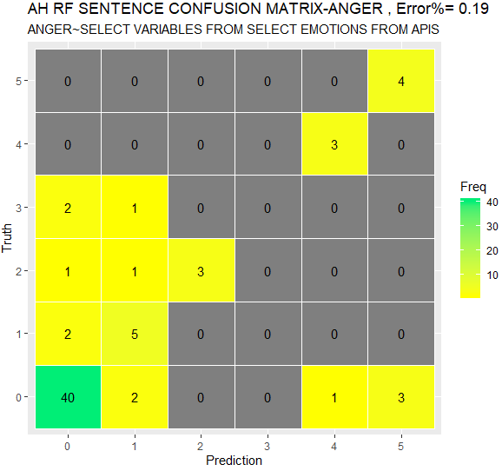
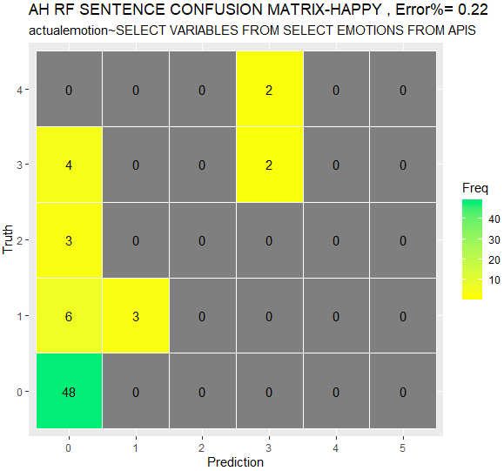
IBM
ANGER
HAPPY
Threshold Considered
Error:
11%
Threshold Considered
Error:
10%

Slide 4
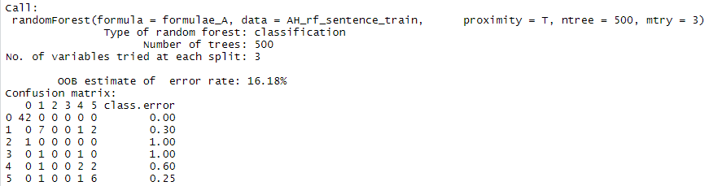
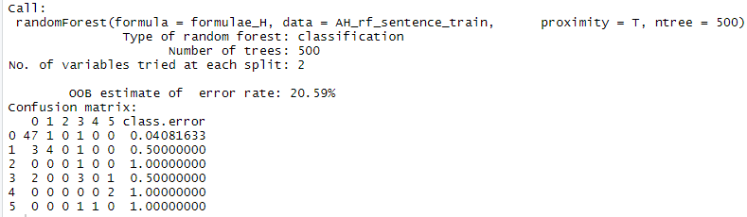
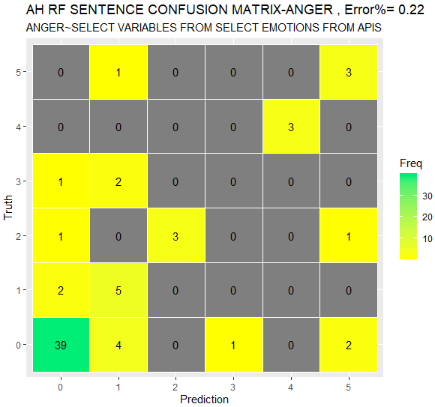
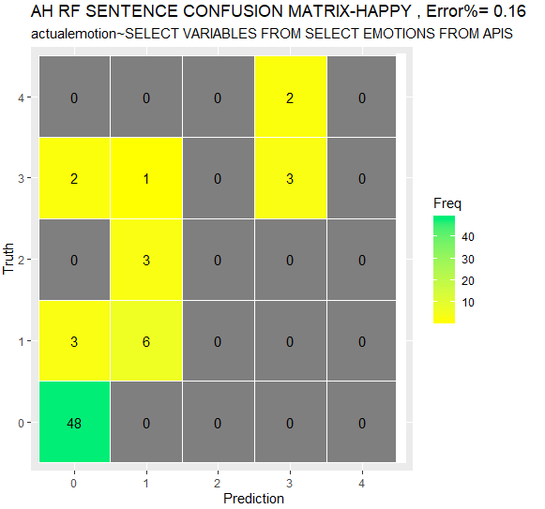
Parallel Dots
ANGER
HAPPY
Threshold Considered
Error:
13%
Threshold Considered
Error:
4%

Slide 5
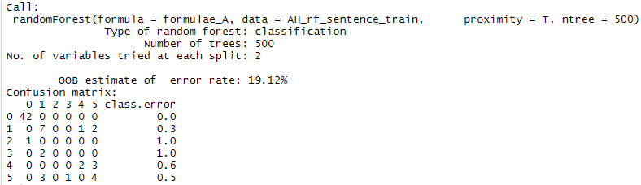
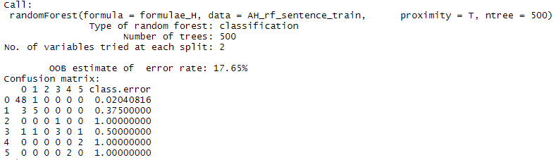
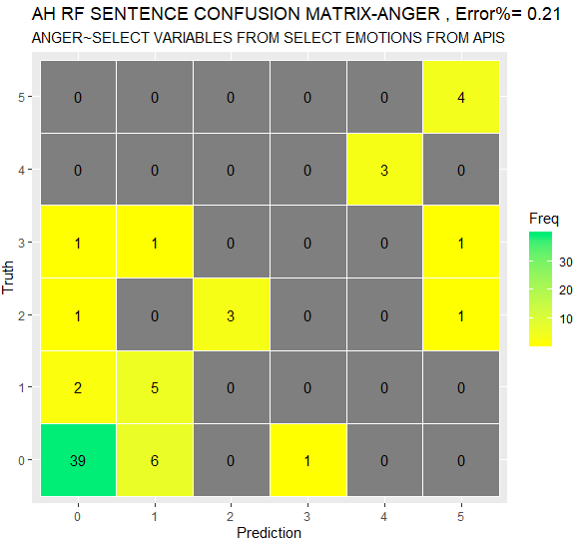
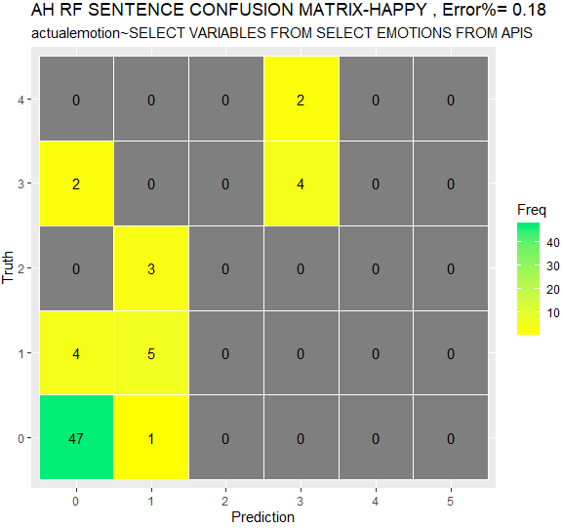
Best Model
[Paralled Dots : angry , happy] [IBM: Anger+Joy]
ANGER
HAPPY
Threshold Considered
Error:
9%
Threshold Considered
Error:
3%

Slide 6
ANGER | MS | IBM | PD | BEST [IBM+PD]
ERROR PAST THRESHOLD | 32 % | 11 % | 13 % | 9 %
HAPPY | MS | IBM | PD | BEST [IBM+PD]
ERROR PAST THRESHOLD | 7 % | 10 % | 4 % | 3 %

Slide 7
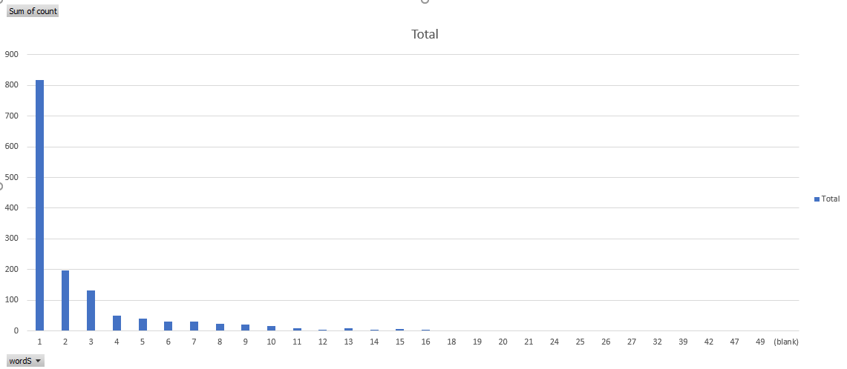
- Single Topic (Cellular Service), introduction of bias
- Most User Utterance are 1 to 4 words long (most cases are number or monetary values such as dollars)
- Scoring File is not formatted properly

